Slide 1

HEALTH-CENTRIC NAVIGATION AND AIR QUALITY MANAGEMENT FOR SENSITIVE POPULATIONS
Yaswanth Pati
Ajay Raj Singh
Sharath Kumar Jagannathan
Saint Peter’s University

Slide 2

Motivation and Problem Statement
In urban areas, air pollution has become one of the most critical threats to public health, significantly affecting individuals with respiratory conditions such as asthma and COPD.
Traditional navigation systems optimize routes solely based on shortest distance or quickest time, ignoring environmental factors like air quality.
Challenge: How can we create a navigation system that minimizes health risks by avoiding routes with poor air quality, rather than just focusing on time or distance?

Slide 3

Project Objective
To develop a health-focused smart navigation system that recommends the healthiest travel routes based on real-time Air Quality Index (AQI) and weather data.
Key Goals:
Obtain real-time AQI and weather data for various route options.
Plan the route to minimize exposure to pollution.
Present users with comparative insights: Health-optimized route vs normal fastest routes.
Dynamic tooltips: weather, AQI, distance, pollutants.

Slide 4

Dataset and APIs
Data Source: Azure Maps APIs:
Air Quality API: AQI levels, pollutant data.
Route API: Alternative routes with polyline coordinates.
Weather API: Temperature, humidity, wind speed.
Data Characteristics:
Real-time, high-refresh data ensuring accuracy.
Latitude and longitude-based dynamic fetching.
Pollution measured in μg/m³ and AQI index standardized globally.
Why Azure Maps? Azure provides a scalable, reliable solution for integrating geospatial
and environmental data into smart city applications.

Slide 5

Methodology
Our project will provide users with the healthiest route options available by including live air quality and weather information. The solution involves the following main steps:
1. User Input:
Users enter their starting point and destination into the application interface.
The interface is text-input and voice-command enabled for ease of use.
2. Geocoding:
The application converts the entered addresses to geographical location in terms of latitude and longitude using geocoding services.
3. Route Generation:
Using Azure Maps API, the app fetches several alternative routes between the given points.
Each route is a set of waypoints with complete path details.
4. Data Collection:
For each waypoint along the routes, the application fetches:
Air Quality Index (AQI): Measures the level of air pollution.
Weather Data: Temperature, humidity, and wind speed.
This data is obtained through real-time API calls to ensure current information.

Slide 6
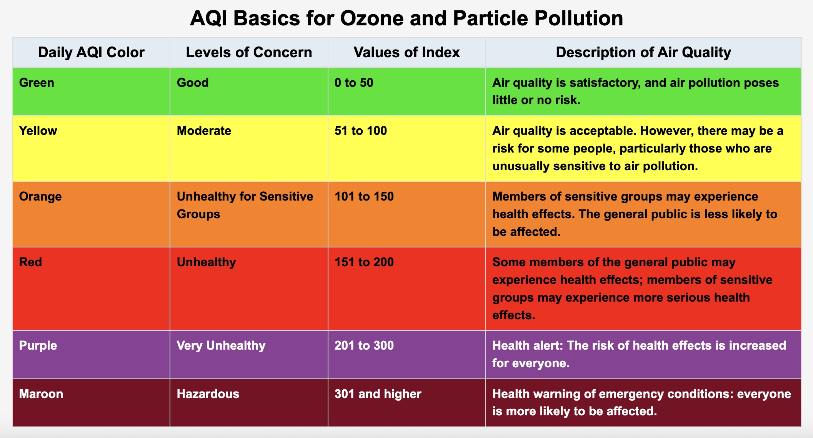
AQI and Pollutant Analysis
The AQI is calculated from primary pollutant concentrations:
PM2.5 (Particulate Matter ≤2.5 micrometers): Fine particles that may penetrate the lungs.
PM10 (Particulate Matter ≤10 micrometers): Inhaled particles that may initiate respiratory issue
NO₂ (Nitrogen Dioxide): Released by vehicles and industrial processes.
O₃ (Ozone): A second-order pollutant formed by reactions fueled by sunlight.
CO (Carbon Monoxide): Released by incomplete combustion processes.
SO₂ (Sulfur Dioxide): Byproduct of fossil fuel burning containing sulfur.
Each pollutant's concentration is translated into an AQI value through standardized equations.

Slide 7
Route Evaluation:
The application calculates the mean AQI for each route by adding up the AQI of all waypoints.
Routes are then compared on:
• Average AQI: Less, the better quality.
• Total Distance: Less distance is preferable if AQI values are comparable.
Route Recommendation:
The route having the least average AQI is labeled as the optimal path for health-focused users.
• Users are presented with all existing routes, which mean:
• Optimized Route: The best air quality.
• Shortest Route: Minimal distance.

Slide 8
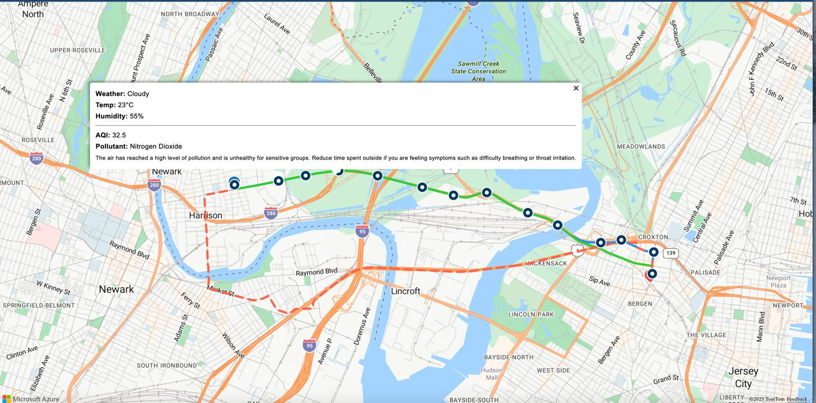
Optimized Route Selection Logic
•AQI data collected every 10th coordinate.
•Distance calculated using Azure’s response.
• Route with minimum average AQI is labeled "Optimized".
• Tooltip shows AQI + pollutant + weather + distance.
In the above image the route is calculating from my home to Journal Square. In that map we can see 3 different routes with different colors.
The blue color is the optimized route with lowest AQI value which can been seen in the tooltip. Apart from the AQI value we can also see the whether data and the dominant pollutant with description.

Slide 9
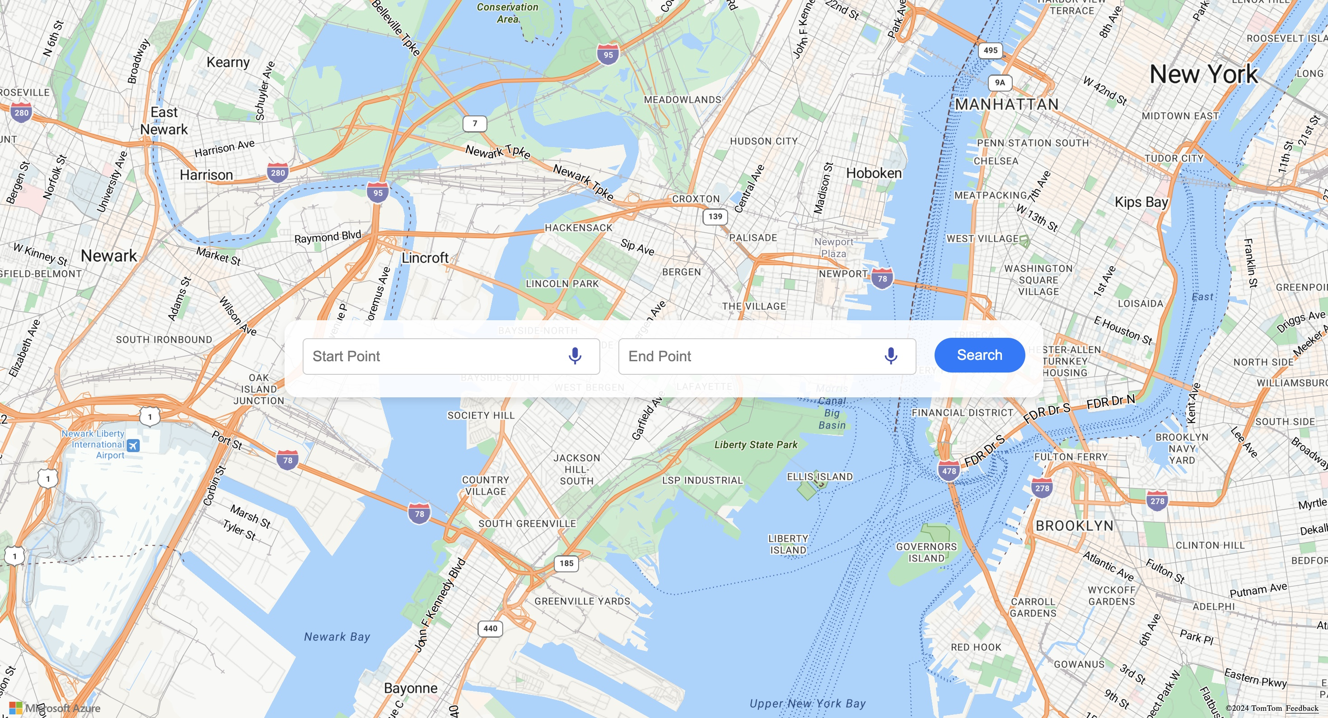
Visuals:
The login page of the application shows the start point and end points of the location. when user enters minimum characters, it detects the location and shows the suggestions. when user click the search button it will navigate to the routing page.
In the Routing page we can see the route between two points with different routes The optimized route consists of points When we click on point, we can see tooltip with AQI, weather data.

Slide 10
Healthier Travel Choices:
This application allows the user not only to select the fastest, but also the healthiest way to travel. Visualization of real-time air quality on a granular route level enables it to support preemptive decision-making — reducing exposure to unhealthy pollutants.
Sustainable Eco-Mindset Model:
The system serves as a framework for the integration of environmental consciousness into transportation technology. It may be easily transferred to mobile GPS software, urban management dashboards, logistics and delivery systems, and EV planning platforms that intend to strike an equilibrium between efficacy and environmental mindfulness.
Support to Vulnerable Communities:
Of best use to people suffering from asthma, COPD, or heart disease, the app provides targeted route options to significantly reduce emissions of air toxics that complicate their disease.
Promoting Urban Mobility Awareness:
Besides instilling AQI awareness into everyday navigation, the project also promotes general public awareness of how air quality impacts health — particularly in densely populated or industrial urban environments.

Slide 11

Conclusion and Future Work
This project successfully demonstrates that environmental factors air quality, in this instance can be successfully integrated into live route planning systems. Employing live AQI data and mapping it against mapping services, we developed a platform that optimizes not just efficiency, but health and welfare, especially for vulnerable groups.
The app is a proof of concept for an official health-based navigation system a giant step in the way of integrating technology and environmental awareness and personal safeguarding.
Future Work:
Mobile Application with Live GPS Integration
Constructing a mobile platform with real-time GPS tracking will enable dynamic, on-the-fly routing that changes based on a user's actual movement and real-time AQI information.

Slide 12

THANK YOU

